Slide 1
Computer Organization and Assembly Language
By Abdual Qaddous

Slide 2
Logical Operations in C
Logical operators ||, &&, and !, which correspond to the or, and, and not operations of logic.
These can easily be confused with the bit level operations, but their behavior is quite different.
The logical operations treat any nonzero argument as representing true and argument 0 as representing false.
They return either 1 or 0, indicating a result of either true or false.

Slide 3
Bit level operation
Expression Result
!0x41 0x00
!0x00 0x01
!!0x41 0x01
0x69 && 0x55 0x01
0x69 || 0x55 0x01
How these Calculated any idea?

Slide 4
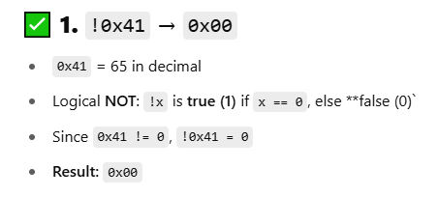
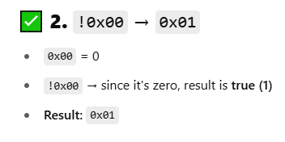
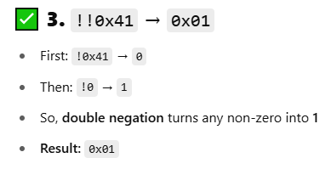
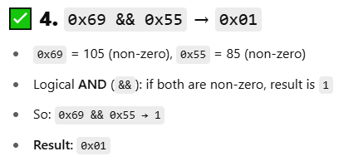
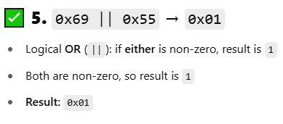
Solution

Slide 5
Bit level & Logical operation
bitwise and logical operators can perform AND, OR, and NOT operations, they do so in fundamentally different ways.
Bitwise operators work on the binary representations of numbers, manipulating individual bits, while logical operators evaluate boolean expressions and return a boolean result.
A second important distinction between the logical operators ‘&&’ and ‘||’ versus their bit-level counterparts ‘&’ and ‘|’ is that the logical operators do not evaluate their second argument if the result of the expression can be determined by evaluating the first argument.
Thus, for example, the expression a && 5/a will never cause a division by zero, and the expression p && *p++ will never cause the dereferencing of a null pointe. How????

Slide 6
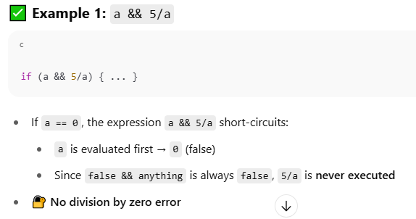
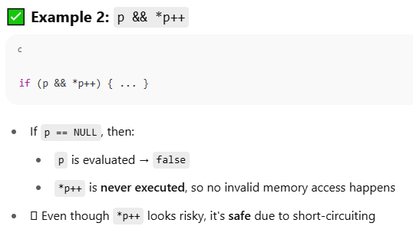
Solution

Slide 7
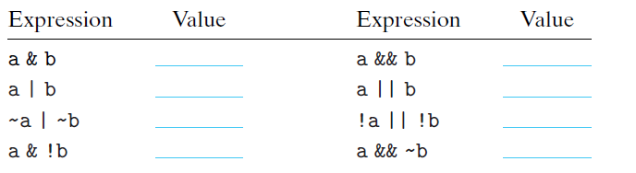
Example
Suppose that a and b have byte values 0x55 and 0x46, respectively. Fill in the following table indicating the byte values of the different C expressions
:

Slide 8
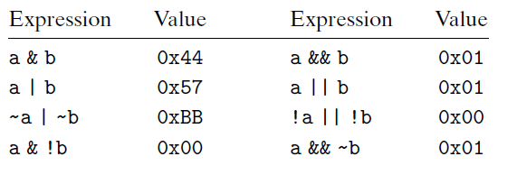
Solution

Slide 9

Solution(1/2)
Expression | Value | Explanation
a & b | 0x44 | 0x55 & 0x46 → 0101 0101 & 0100 0110 = 0100 0100 = 0x44
a && b | 0x01 | Both non-zero → result is 1
a l b | 0x57 | 0x55 l 0x46 → (0101 0101) l (0100 0110) =
a l l b | 0x01 | Both non-zero → result is 1
~a l ~b | 0xBB | 0x55 l 0x46 → ~ (0101 0101) l ~ (0100 0110) =
~a l l ~b | 0x00 | Both non-zero → result is 0(invert 1 to 0)
a & !b | 0x00 | !b = 0, a & 0 = 0x00
a && ~b | 0x01 | ~b = 0xB9 (non-zero), a && ~b = 1

Slide 10
Practice
Using only bit-level and logical operations, write a C expression that is equivalent to x == y. In other words, it will return 1 when x and y are equal and 0 otherwise

Slide 11
Solution
The expression is !(x ^ y). That is, x^y will be zero if and only if every bit of x matches the corresponding bit of y.
We then exploit the ability of ! to determine whether a word contains any nonzero bit.
There is no real reason to use this expression rather than simply writing x == y, but it demonstrates some of the nuances of bit-level and logical operations.

Slide 12
Shift Operations in C
C also provides a set of shift operations for shifting bit patterns to the left and to the right.
For an operand x having bit representation [xw−1, xw−2, . . . , x0], the C expression x << k yields a value with bit representation [xw−k−1, xw−k−2, . . . , x0, 0, . . . , 0].
That is, x is shifted k bits to the left, dropping off the k most significant bits and filling the right end with k zeros.
The shift amount should be a value between 0 and w − 1. Shift operations associate from left to right, so x << j << k is equivalent to (x << j) << k.

Slide 13
Right Shift
There is a corresponding right shift operation, written in C asx >> k, but it has a slightly subtle behavior. Generally, machines support two forms of right shift:
Logical. A logical right shift fills the left end with k zeros, giving a result [0, . . . , 0, xw−1, xw−2, . . . xk].
Arithmetic. An arithmetic right shift fills the left end with k repetitions of the most significant bit, giving a result [xw−1, . . . , xw−1, xw−1, xw−2, . . . xk].
This convention might seem peculiar, but as we will see, it is useful for operating on signed integer data.

Slide 14
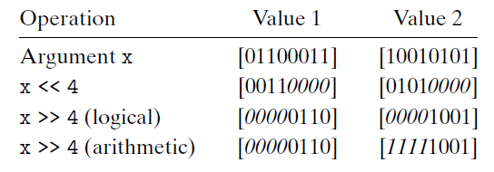
Example

Slide 15
Explanation
The italicized digits indicate the values that fill the right (left shift) or left (right shift) ends.
Observe that all but one entry involves filling with zeros.
The exception is the case of shifting [10010101] right arithmetically. Since its most significant bit is 1, this will be used as the fill value.

Slide 16
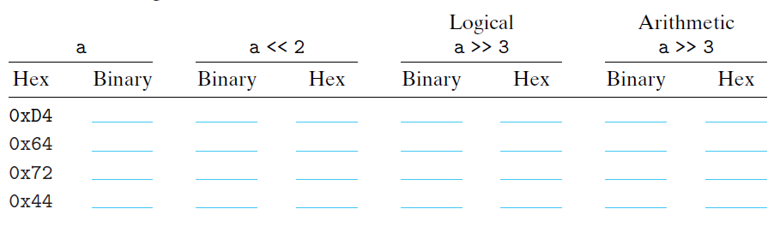
Practice

Slide 17
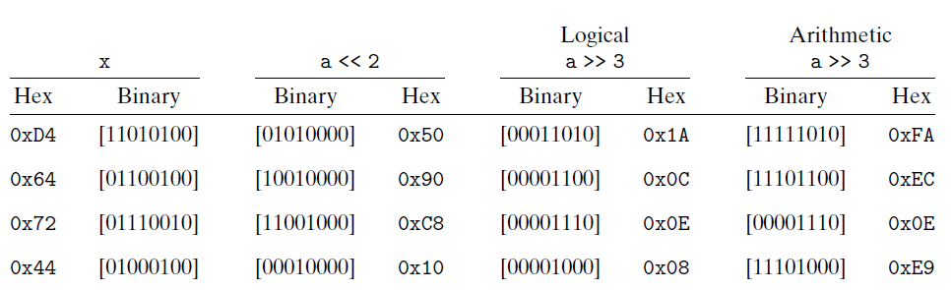
Solution

